Slide 1
River-Tripping, by Eric Hermann – main topics
Pre-zoom reading: a plan sheet and packing list I sent to members. Recall, re-visit Richard Ferguson’s Zoom on rigging.
1. Early planning – six months to a year: Is this the river for your group?
2. Maybe two months out: Group gear, shuttle plan, good maps or river guides.
3. Role of trip leader/Coordinator vs role of members
4. Equipment
5. Food Plans
6. Fires, Porta-Potties, and the Camp.

Slide 2
Overall Principles: All for one, one for all: you’re a team. Maintain safety, wearing life vests (pfd’s), stay together No unnecessary risks! Who in group has training and skill in rescue, first aid? Do practice with throw ropes. Early on the water is best! Google “Leave No Trace” sites for American Canoe and American Whitewater—and other Leave-no-Trace sites. Group Spirit: Positive, Fun, Forgiving, Ego-free. Maintain it!

Slide 3
How and where to learn river-tripping
Short trips, good weather, easy rivers and lakes.
Green River in Canyonlands and in Wyoming
North Platte below Saratoga,
Ruby Horsethief (Loma to Westwater) Class 2.
Gunnison – Delta to Whitewater
Yampa in Duffy Canyon near Craig.
Lakes with multiple campsites

Slide 4
Craft
Rafts - Lotta camp gear, one big drybag/person
Canoes - straight-bottomed canoes for flatter water, rockered (hull curved like banana) for Class III or more. Know strokes very well, and eddies, and back-ferrying!
Inflatable Kayaks—same concepts as canoes. Self- bailing best, but wet seat.
Hard Kayaks- minimal gear but usable.

Slide 5
Planning, stage: six months to a year away
You get the bug, learn what to expect. Difficulty: Fit the river to your group or fit group to the river. Remember: Loaded craft is harder to maneuver. Permit needed? Attend permit party. How do you learn about your planned river?
Ask those who’ve done it. Try American Whitewater site.
When are flows best for you? See graphs, e.g., “Flows San Juan River.” Maybe avoid high-water in class 2 or more.
You-tubes of trips or Google for trip reports. River guidebooks.
Great book on Amazon: Canoeing Wild Rivers by Cliff Jacobson

Slide 6
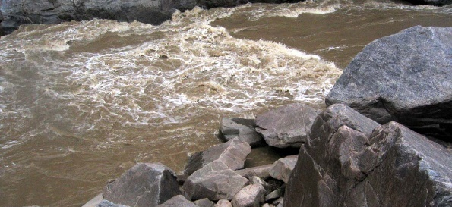
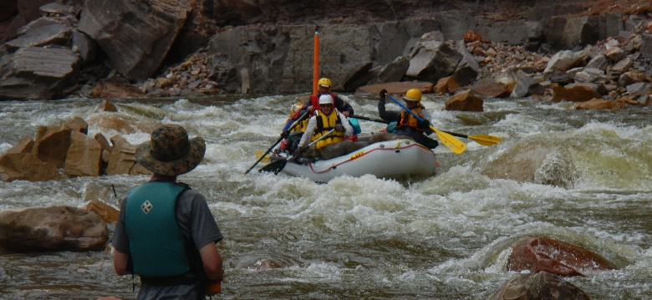
Can we do a rough river, just line/portage rapids?
Lining – guiding boat with ropes as you walk the shoreline. Google how to use a lining bridle (attaches rope at or below the waterline for stability.)
Lining or portaging can be dangerous! See the shore in Skull and Warm Springs rapids?
Skull Rapid, Westwater
Warm Springs, Yampa

Slide 7
Trip Leader/Coordinator Role
Not always the permit-holder.
TL/C Ideal: Makes decisions as needed, with a hand that is not felt.
Coordinates well ahead, including equipment; sets commitment dates; invites. TL/C needs people to communicate in timely manner in planning!
Gives safety talk at put-in. Set morning schedules.

Slide 8
Member Responsibilities
Planning: Reply to messages from TL/C! If you’re not interested, reply quickly, with thanks. Soon he/she will need your commitment. TL/C can invite others if you’re not sure—c’mon, respond! Don’t invite others on the trip without TL/C permission—only TL/C invites!
Help pack, help set up, take down camp. Don’t just watch!
Don’t delay departure or delay travel down river!
Rehearse with tent, stove, packing boat.
Be nice! Kids, pets, behavior

Slide 9
Planning Shuttles (much depends on the length)
Your own? Shorter ones, cheaper, but cost time. Drivers drive cars to take-out, return in1 car, to be left or shuttled.
Shuttle companies: Usually listed in river details on government websites or American Whitewater (AW). River Geek.com, Google, e.g. “San Juan River Shuttles.” See ratings. Cost is shared. Shuttle company regs, like full tank and good tires and engine. Where to leave key? Tips? Keep a key. Parked cars get hot! Phone shuttle company, fill out application on their website.

Slide 10
Planning – Maybe two months out
All must read Regulations
Usual requirements:
Life jackets with whistles, fire pan and minimum dimensions (required even if no fire), Do you want a fire?) Use fire blanket?
porta-potty (groover), patch kit, Extra paddle/oar, throw-rope (length), first aid, stay together (in sight), dogs? Maximum group size, assigned camps? Strain food particles. No soap in river, extra life vest, helmets, pin kit (pulleys and straps to extricate a pinned craft.)

Slide 11
Equipment
Boat rigged for tripping, with 20-30-foot floating front painter. See Zoom presentation by Richard Ferguson about boat-rigging. Paddles, accessible extra paddle, bailer, throw-rope. Flotation? See regs. Average clothing/gear bags give about 70% buoyancy of float bags.
Waterproof (submersible) containers – see NRS and Jack’s Plastic websites, or barrels (Boundary Waters.com). A little water can still leak into a dry bag. Best plastic bags? Trash-compactor bags.
In rivers, lash gear tightly to boat.
Some folks like emergency-message systems, like Garmin Inreach, which lets folks at home know you’re fine and allows emergency messages.

Slide 12
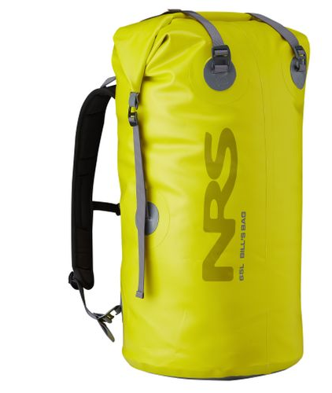
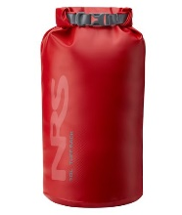
Dry Bags – Must learn to pack correctly
Dry-bags- maybe a large (65-110 liter) bag and a small (10- 15L) per person. Small bag holds contingency gear, like rain jacket/pants, fleece, wool hat, small first aid kit (one per boat), fire lighter, tp, snack bar, etc.
Pack soft stuff near top, squeeze air out, put soft stuff on top, fold tight to it, then clip shut.

Slide 13
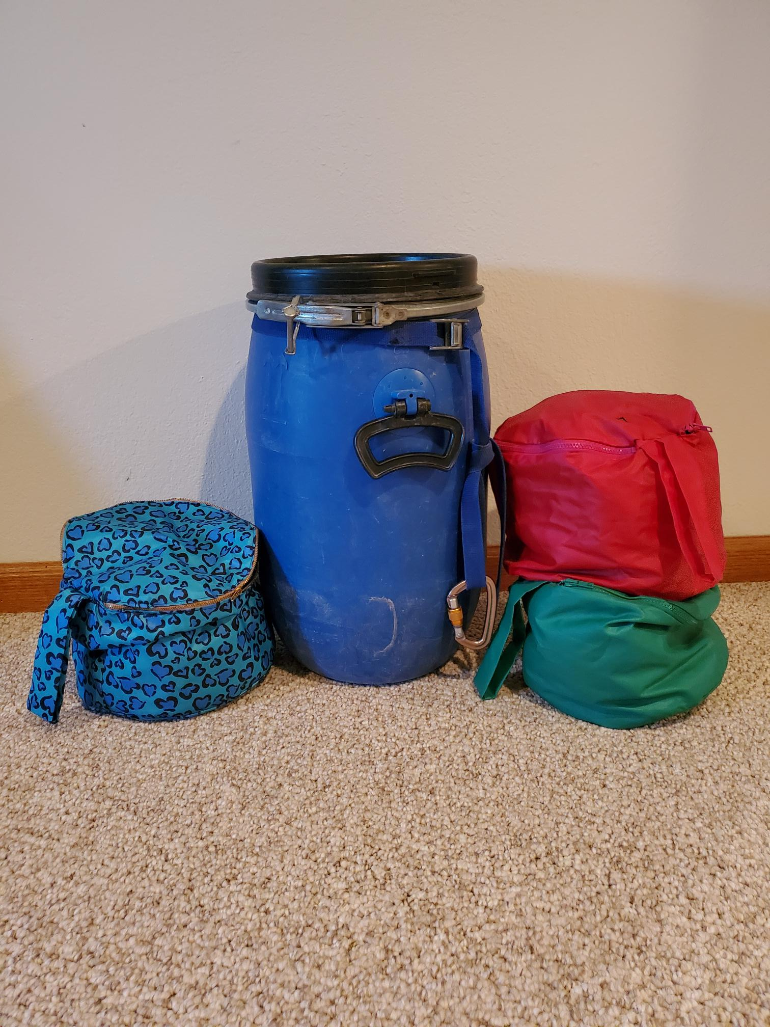
Barrels
Barrels: Many folks like these: hard-shell, waterproof, critter-resistant
Should have circular barrel-bags inside to avoid blind rummaging. Nylon shopping bags could work for barrel-bags.
Check Boundary Waters.com $75 or $100.
Deb Hinde’s Barrel Set-up

Slide 14
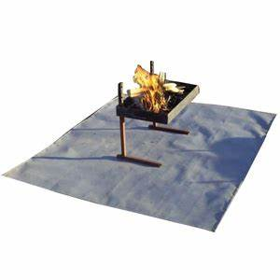
Fire Pans – check regulations for minimum dimensions.
My Collection of home-mades
Top: My salvaged stainless box, jury-rigged with legs and grill. 4 lbs
A used portable charcoal grill. Sits on rocks on fire blanket 2 lbs
Front: Aluminum turkey-roaster (As emergency on no-fire trips. Be sure rangers will approve.) 8 oz.
Ammo box to carry ashes. Paint cans could work.
13” steel pan – again, for no-fire trips.
Commercial pan with fire blanket. 28 lbs, $275
Often legal for kayak trips – no pan, just blanket

Slide 15
Sleeping quarters
Tent – know pitching: rehearse! Test waterproofing. Raining? Learn to pitch fly first, then tent beneath.
Sleeping bag – Down is nice but has to be protected. Some companies offer a water-resistant down. Primaloft is good, even has some “wet warmth.” Consider a compression sack.
Pad – Whatever you like. Should be quiet when sleeper squirms. Bring a patch kit.
Tarp with poles –for rain or sun. Rehearse pitching quickly!

Slide 16
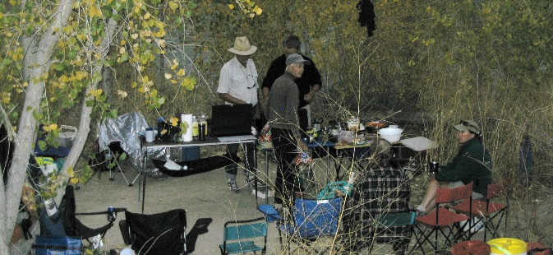
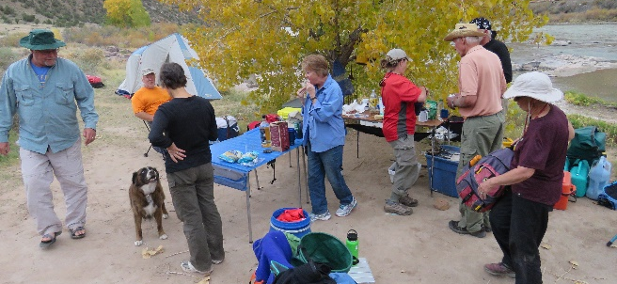
Kitchen: Not for backpackers!
Notice the comfort of tables n chairs, circled for fun, conversation!
Notice: it’s open and flat. Easy carry from river.

Slide 17
Kitchen Gear
Stoves: Two-burner propane/little green tanks or larger? Backpack stove? 1-burner Coleman? Test at home first.
Tables? Roll-ups good, especially with metal top for stoves.
Pots n Pans – should nestle, easy-to- clean. Pot-grabber, Food strainer.
Dishwash pans and soap/scrubber.
Chair! They make some to fold into very small packages.

Slide 18
The Groover! (see regs for human waste procedures)
Leak-proof container! Have reminder to repack groover! (Some groovers get left behind!)
For solid waste only (pet waste too), urine goes in river.
With large Eco-safe you can buy multiple liners)
Wagg-Bags: Easy and cheap.
Tube style (See how-to vid on Google)
Suggest renting a groover at first, which usually includes clean-out. Often offered by shuttle companies.

Slide 19
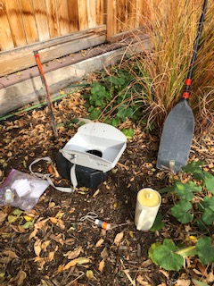
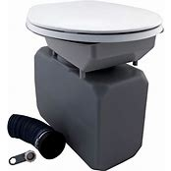
The porta-potty….Groover!
Large Eco-safe , about $200, on right. Can rent.
My little boombox, ready for packing
Set-up. Paddle to signify “occupied” Pee bottle at ready!

Slide 20
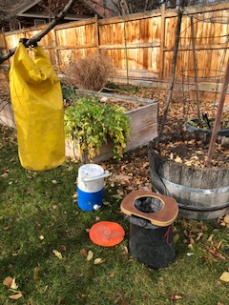
The Wagg-Bag and Tubular Systems
My Wagg System: Cone made from ABS landscape pot (packs flat), orange is cover for hole. Used bags carry in jug.
Tube of 3” ABS: light, small
Wagg bags – disposable. Carry in hard, waterproof container.
Tube - users poop on round coffee filter or tp, push into tube, with pressure relief valve) Google “Kayaker Waste Tube.”

Slide 21
Planning: About a month out.
If it’s a permitted trip, hold off printing permit until a week before so you can make changes to it, like number of people or types of crafts.
Then print multiple copies so another person can carry as well.
Who brings what group equipment? (all help carry) See plan at end of this.
Can you filter water or do you carry all of it? One gal/person/day. Two smaller containers better than one large: packability, spills.
Make a food plan
Food guarded against critters? (Bear-proof coolers, electric fences, or bags high in trees)
Beauty of layover days: hike, dry the gear, extra travel day if needed.

Slide 22
Food Plans (Refer to no-trace rules)
Breakfasts/Lunches: Best to let folks plan/prepare their own. Easy, quick: No bacon/eggs, pancakes.
Dinner: Best to do as much prep as possible at home. Consider boil bags instead of scraping pan-crust!
Emergency meal if weather shuts down kitchen. Don’t go to bed without eating—especially if it’s cold.
Learn (Google) the four-pan dishwash method.

Slide 23
Dinner Plans – Do most prep at home!
Dinner Plan A, Whole Group: Each night a sub-group provides dinner.
One 2-burner stove/fuel for up to 8 or 10 people, maybe a one-burner back-up. One pot/pan set for group.
Maybe next night’s crew washes dishes?
Dinner Plan B, Independent, or pairs. (Pic of Roger, etc.)
One-burner stove for each person or pair. Maybe freeze-dry foods.
Dinner Plan C, Tapas or Appetizers
Little planning needed, no cooking in camp, very little dishwashing.

Slide 24
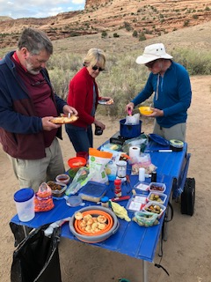
Tapas/Appetizers on the tables – some meats, some veggies, some full of guilt!
No cooking, little cleaning!
Pass the shrimp!

Slide 25
Coolers and Their Management
Coolers yes or no?
No: Large, bulky, heavy Yes: Ice cubes, fancier food. Keep em small, efficient. Open only twice a day.
Critter-proofing? Include electric fence. Cooler in boat? Waterproof?
Keeping cold in: Lay wet towel on top… Dry ice? No. Open as rarely as possible…Shade…Designated coolers. Drag beverages.
On long trips plan some coolers not to be opened for days.

Slide 26
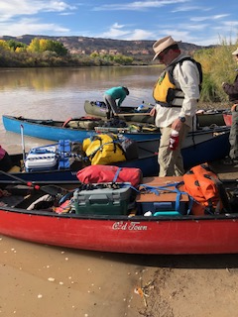
Notice coolers in each canoe
That’s a lot of space! Without them, the load could be below the gunnels!
But they do keep food/bevs cool and un-crushed. Front one is water- and air-tight.
Front shows homemade dry box (from Rubbermaid, gasket added, bungeed tight (not for class 3) Marine plywood forms a table and squeezes gasket.

Slide 27
Fires, yes or no? See regs: Banned?
No to fire: Much less equipment to carry, no wood to carry or if legal, collect; smoke-free, less impact on environment, less danger. And you can watch stars! Propane fire-pit? Candles?
Yes fire: Warmth, togetherness, tradition, some cooking.
See no-trace rules. Check for fire bans. Keep fires small.
Fire Pans
Fire Blanket – Welding blanket 4’ square
Safety – clear of brush/grass, burn down, then water down at night? Steel screen for embers. No morning fire unless layover.
Carry cool ashes out in sealed metal container.

Slide 28
The Trip is On: Here ya go!
Put-in: ready/efficient – bags packed, ready for boats, Go early, All help. Drivers shuttle; packers pack boats.
Safety Talk by TL/C: Stay together (in sight), wear life jackets and whistles, risk-taking, signals with whistles and paddle, stops for hikes, lunches. Rescue procedure, like how to catch a throw rope when you’re swimming. Look after each other (eyes on life jackets, helmets, hazards, etc.) Re-group after islands.
Day one is short. Rapids days are short.
Remember: Layovers, maybe 1 per 5 days, are wonderful!

Slide 29
At Camp
Lead paddlers must recognize camp!
Land facing upstream, leaving space for others. Help land boats.
Tie securely (wind and river surges) Sponge and flip canoes?
All help until setup is done. Setup is weather-dependent—tents first? Look for possible limb-fall and drainage pattern.
Set up groovers well away and outa sight.
Social time, then dinner and wash before dark.
Reminder of morning’s embarkment plan.
Fire, maybe, then put camp and fire safely to bed.
Observe quiet time.
If you feel hypothermic, etc., tell TL/C.

Slide 30
…And the take-out
Early embarkment, think of wind, discuss plan.
Lead paddlers must know take-out by sight. Stay together!
At take-out: Leave room for your group and others. All help!
Separate piles for separate cars
Plan a trip pix and celebration party.

Slide 31
Loading your boat…
Hah! Not like this! (On a Westwater trip I jokingly boasted that my 10-foot canoe would hold all the gear a raft could. Result? Two more strokes then submarine!)

Slide 32
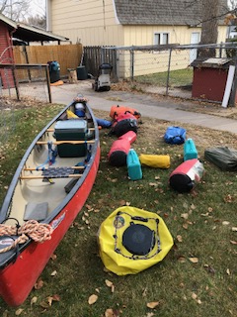
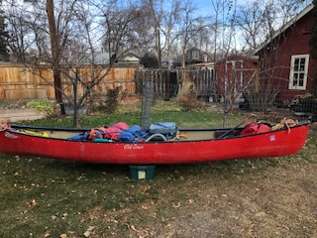
Packing details: Left, groover fits under deck. Center, gear in dry bags ready. Right, loaded and testing balance. Cooler is bulky!

Slide 33
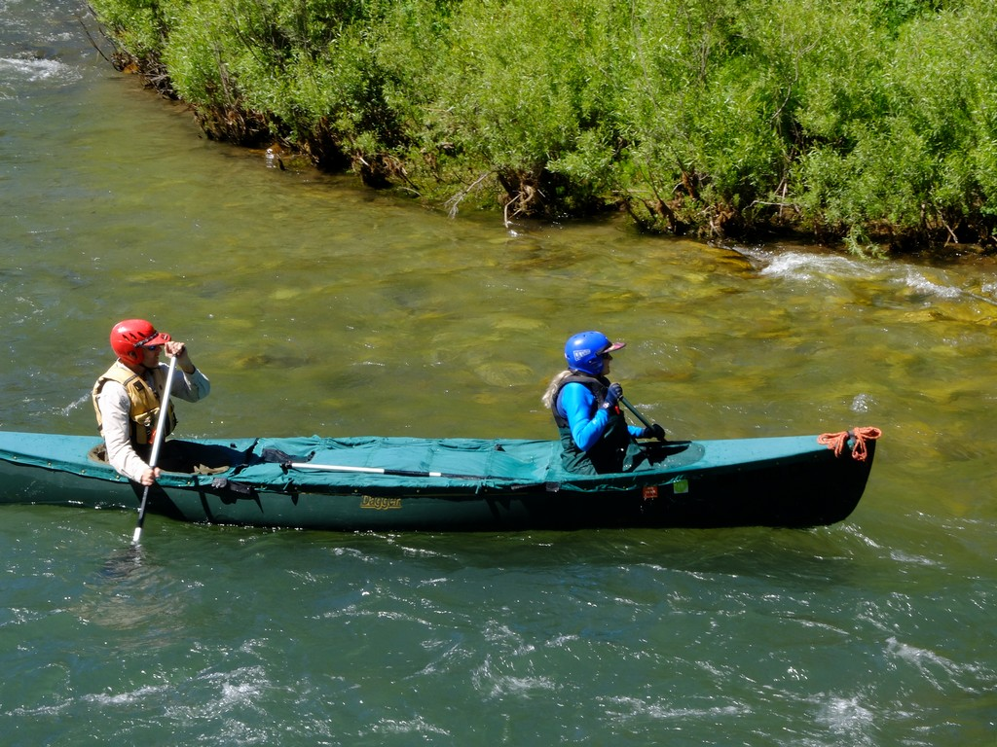
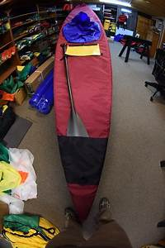
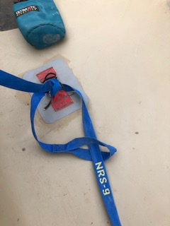
Left: I like this kind of strap. Center: Cooke Sewing solo cover, as recommended by Paddlers member Paul Lang. Right Cooke tandem cover. About $575. Cover blocks waves and rain, cuts wind resistance. But can also entrap capsized paddlers.

Slide 34
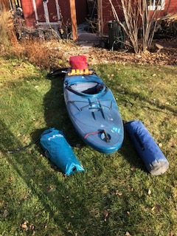
Packing into a hardshell kayak
This is a hatched kayak for self-support trips, a Liquid Logic Remix 9.
I remove foot pegs, then work NRS stow float in one front channel. It has clothes, maybe a compact air mattress.
Other front channel has very small 2-man tent (Big Agnes Fly Creek), sleeping bag—if down, likely in a plastic bag.
Rear hatch: food, stove, some water etc. Hatch leaks, so use dry bag. Water capacity is very limiting factor!
Space behind seat: Throw bag, rain/emergency clothes.
Note groover strapped behind seat.
Google “self-support kayak trips.” Very minimalist!

Slide 35
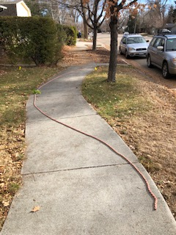
Shallow River: Where is the deeper current?
Notice Río Acero here: Now your heavily loaded canoe is looking for enough depth to float. Strongest current pushes to outside bank, therefore channel is along the red rope.
However, strainers (parsley bunch) happen along outside bends. So round the turn upstream cautiously, eyes open! A back-ferry would miss the danger.

Slide 36
A Planning Sheet, Page 1
2021 - weather predicted as of 10/4: high 55-65, low 32, rain Tuesday pm and eve. Flow 10/4 3380 (good)
Vail Pass 10/10: Snow and Rain likely. No fire ban 10/4
2021 Personnel: George X (cell 606 431 3456), the Y’s (cell…) List continues
Put-in Monday, Oct 11. Take out Wednesday, Oct 13.
Regs: Please review the regs: https://www.recreation.gov/permits/74466/additional-information Must have throw rope and bailing device, extra paddle, groover that carries its contents in a hard shell.
Night before put-in: (Motel or Campground info)
Eat together eve of 10th? Mex. rstrnt (behind Supermkt, then east) is very good.
We usually reach take-out at Westwater Ranger Station about noon, and finish packing gear in cars about 2. Some decide to drive all the way home, and some to motels.
Shuttle : Split into drivers and boat-packers. Gear should be ready to drop quickly—already packed in the dry bags, etc. Drivers then take the cars to take-out and return in truck, which will then be shuttled by Rimrock.
Put-In: Meet Monday morning, 10/11, at Put in at 8:00 a.m., quickly set gear next to boats. Shuttle drivers drive cars to Take-out, leaving by 9:00, back by 11:00. Boat-riggers rig while they’re gone.
Directions to Westwater for take-out: Cross Utah border; Westwater Ranger Station (the take-out for Ruby Horsethief/Loma Run): From Interstate 70, take exit 227. Turn south at the stop sign and proceed for nine miles to the Ranger Station. Alternate Route: From I-70, take exit 221. Turn north at the stop sign. Turn right onto the road paralleling I-70. Turn left shortly after passing over Westwater Creek. Follow this road for 4.5 miles to the Ranger Station. Do not attempt this route during or shortly after inclement weather. The section of the road under the Interstate becomes impassable when wet.

Slide 37
Planning Sheet, p2
Group Gear (share the load in boats, even if it isn’t your gear)
Firewood: Hermanns and _Pete_ if there is no fire ban.
1-2 stoves: Two-burner Stouts, plus single-burner Hindes
2-3 tables : Debbie, Pete, maybe Stouts (can leave in car) lantern: Herms,
pots and pans: __ Richard: 1.5 qt pot. Debbie the rest. A likely set of pots/pans: large pot, like 2-gal; 2 medium pots, like 3-qt.; lids; pot grabber; maybe a fry pan. Coffee apparatus?
Eating utensils, (bowls, plates, cups, knife,fork,spoons) trash bag etc. - bring your own. Maybe something to cover food on table (flies, yellow jackets) Beverages: byo. Cocktail ice!
2020: Dishwash stuff (w/ strainer) Debbie Handwash system – Hermanns
fire pan, woodsaw, and grill Hermann. Does anyone want grill on firepan?
Fire blanket: Richard
Kitchen Floor? Debbie, if you want one.
1 tarp with poles: Tarp Herms Poles Deb: Herms tarp is rectangle 10x12. Anyone have larger one? My second tarp
bottled propane? 3 green bottles, brought by Stouts Groovers: Individual.
First Aid Kit – Large Kit: Hinde Ea. Boat must have a small one—band aids, pills. Specific medical needs, like epi-pen (must, if bad allergy!), up to individual.
Food: BYO lunch and simple breakfast.
Extra pfd (life jacket) ___? __
Dinners All appetizers Yes, they can be healthy! Person X can eat veggie, fish, fowl , non-gluten, folks can prepare some of these. Any other requests or cautions? Allergies?
Water: BYO (at least 3 gallons per person)
Ice cubes: _______________
Drinks: BYO Gin/Tonic, Beer, Pop, etc.
Dinners- All appetizers Deserts ? There are reports of bears—store accordingly
So….

Slide 38
Equipment List – River Trips: Master list, to be edited down
Canoe - paddles, painters, flot/ straps, bailers, sponge, throw bag, xtra paddle, back rests, repair kit w/ duct tape, pin kit
`Have one place for staging gear for leave-behinds
Small, quick-grab dry bag (rain gear, warm clothes, minor 1st aid, lighter, snacks), map/compass, water bottles, drag-bag; mesh sack to drag drinks. Lock?
PFD’s a must. Extras pfd? Helmets?
Group Gear: Who will bring…
Stove/fuel (two-burner per 8-12 ppl) Clip liquid fuel in boat, not in dry bag!
Bkpk stove?
Cook kit, (per 8-12ppl) with spices, strainer, paper twls, pot grabber, hot drinks,
2-3 lighters, dshwash,coffee stuff Utensils, bowls, cups: BYO
Table(s) trash bags, lantern, batteries. Dishwash/handwash, Major 1st Aid Kit epi and personal meds reminder?
Tarp/pole, sm. tarp for wood Fire Pan/blanket, Ash can, wood, lighter, saw,axe?
Camp Stuff
Tent, Sleeping bag and pad, pillow
Water jugs: 1 gal/person/day (2 small jugs better than one large) Water filter And purif. pills!
Chairs, etc. Lunch Cooler
Groover, Set up to check parts! (Reminder in boat to pack it.) Trowel/day pooper, p-pot, Purelle, TP multiple places
Maps – wtrprf- & boat compass
Sunscreen, Bug repellent
Personal Clothing/Gear
Wool hat-almost always rain/sun hat/insect headnet? Sun/insect lotion
Wet or dry suit? Gloves? (biking gloves great for paddling)
Extra glasses – safety straps and repair kit important
Hooded rain jacket and pants. Down jkt ok in camp, not on river.
Long undrwr, fast-dry pants. Wool/fleece if cold.
One suit very warm, dry clothes very accessible
Camp/trail shoes, extra sox, layered tops (no cotton unless it’s warm)
Hot weather – shorts, etc., but cover skin from sun—even ankles! Swimsuit
Daypack, etc. for hikes; Camera with floats, ex batteries–waterproof storage!
Matches (lighter), fire starter, knife, sharpener, Headlamp, xtra hdlmp, batteries,
Toiletries, towel, wash rag, reading material, star chart
journal, pen, marker for labels, snacks, lunch in day-bag Essentials – Don’t forget SHUTTLE KEYS! Permits, driver’s license, cell phone/numbers of group.

Slide 39
And…
The End

